Slide 1
Threat Landscape Updates
Bob McArdle

Slide 2
1. Changes
What are the main CHANGES we have seen in Cybercrime in the last 3-6 months
Notes:
As usual 3 Sections – what have we seen CHANGE in the last few months, what are the EVERGREEN ITEMS that are always in the background, and any PREDICTIONS for the coming 6 months. We’ll start with Changes

Slide 3
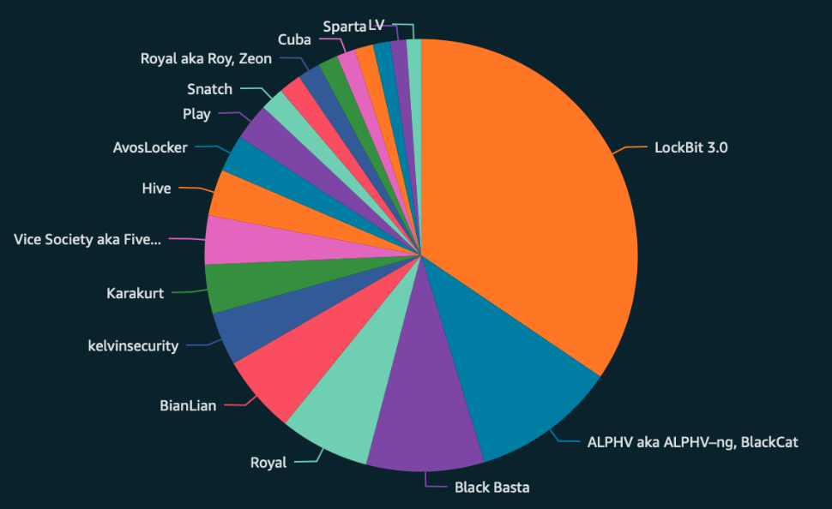
Changes
Ransomware
Top 5 Actors are quite consistent, with others making the headlines normally for more innovative attacks rather than high volume e.g. ESXiArgs, Buhti
Activity increase in Jan-Feb 2023
Lockbit still dominant – launched new “Lockbit Green” edition
Interesting forum argument with ”Baddie” ion Exploit
Some blurred lines between state / criminal actors : Cuba / Vendetta affiliate observed targeting Ukraine
Notes:
Can see Stats for the last 6 months here. Top 5 Actors are quite consistent, with others making the headlines normally for more innovative attacks rather than high volume e.g. ESXiArgs, Buhti (Linux Golang)
After initial Dip in the Leaksites in January, things returned to normal in February. A caveat here that the Leak % will vary by group – but the recent Hive takedown is a great example (209 named victims vs 1500 claimed victims). Avaddon had 200 named victims but 3000 keys released. So the real impact is an order of magnitude higher .
In fact there has been a real uptick in Ransomware in the last 2 months, which even though not reflected in the leak sites yet, we are definitely seeing in our internal numbers and IR cases in particular. This business model is most definitely not going away anytime soon – its just getting more refined.
Lockbit has continued to evolved with a new version Lockbit Green based on Conti source code, which looks to replace their current product – called Lockbit Black (or v3.0) which was based on Blackmatters code base.
There was an interesting forum argument with Lockbit and an Actor Baddie on Exploit
The actor Baddie (who runs an affiliate program, possibly associated to Royal Ransomware) claimed LockBit collected competitors' ransomware for unclear reasons, and LockBit responded by claiming it is for comparative testing only to prove LockBit's advantages over other strains.
The actor LockBit also accused Baddie of cooperating with the Russian Federal Security Service (FSB) and claimed the infamous criminal Maksim Yakubets worked within their team. However, no proof of this statement was offered.
ROMCOM Backdoor Affiliate example

Slide 4
Hack the Servers!
Initial Exploitation via server is very popular right now
Sugar CRM CVE-2023-22952
ManageEngine ServiceDesk CVE-2022-47966
GoAnywhere CVE-2023-0669 (possible TA505)
Vmware ESXi CVE-2021-21974, CVE-2020-3992 (ESXiArgs / Royal Linux)
MySQL Server abuse remains high
Once in persistence normally via Remote Management software such as AnyDesk, ScreenConnect, TeamViewer etc.
Notes:
Even for bugs that are 2 years old like the VMWare ESXi server CVE, these are back and popular once more – for example in the ESXIArgs campaign in early February, and Royal Ransomwares Linux variation
Key message – be very sure of the patch levels of all of your internet facing servers – because the attackers certainly will be.
Examples:
https://www.securityweek.com/recently-disclosed-vulnerability-exploited-hack-hundreds-sugarcrm-servers/
https://therecord.media/cisa-adds-oracle-sugarcrm-bugs-to-exploited-vulnerabilities-list
https://www.bleepingcomputer.com/news/security/cisa-warns-of-critical-manageengine-rce-bug-exploited-in-attacks/
https://www.computerweekly.com/news/365530128/Ransomware-operator-turns-their-fire-on-two-year-old-VMware-bug

Slide 5
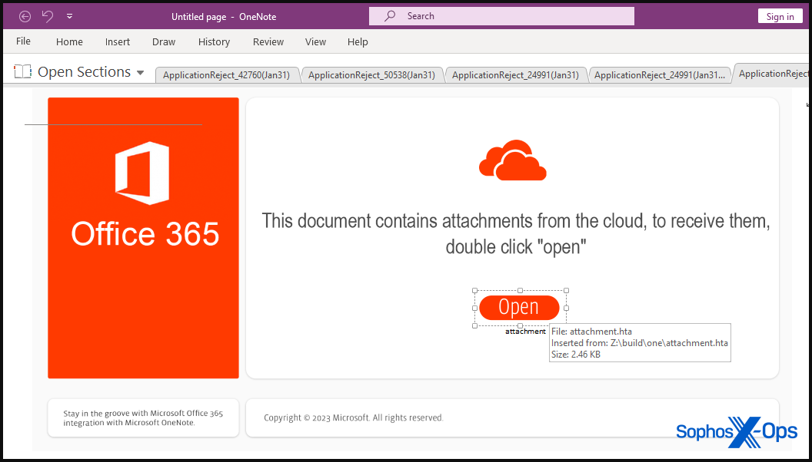
OneNote
Use of OneNote files to deliver malware
Have seen uses with
Qakbot
RedLineStealer
Cobalt Strike
IcedID
BumbleBee
Kill Chain leading to BlackBasta
Various RATS
Notes:
Big increase in use of OneNote files to deliver malware – normally PowerShell, other malicious docs etc
Here are some example we have seen – in short – basically all the major groups have latched on to this with the removal of Macros as a good way to deliver malicious code via Email

Slide 6
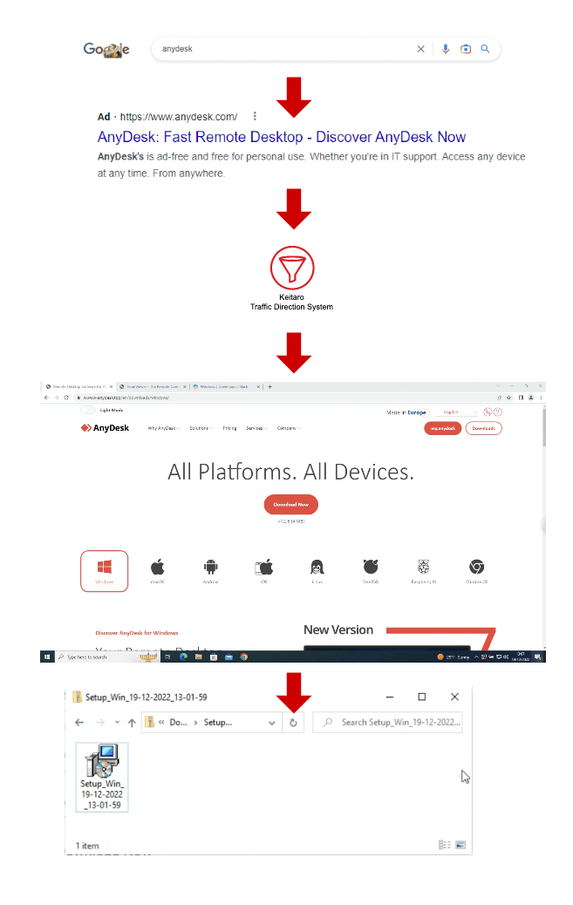
Google Ad Abuse
Google Ads for Popular Software were heavily abused(now better)
Have seen uses with
IcedID
Gozi (ISFB / Ursnif)
RedLineStealer
TA505
Vidar Stealer
Notes:
Another major change in delivery mechanism in the last 3 months has been the use of Malicious Google Ads during December and January, although it seems Google are starting to get control of this now
The way the attack works was that attackers seemed to buy Google ads for popular software such as Adobe, Discord, Slack etc. When the user clicked on the sponsored ad they would be lead to a realistic looking installer page with strangely did not have their best interests at heart. This would normally lead to an MSI installer, which in turn would kick off a kill chain with one of the following malware. They often inflated the size of the MSI also to both be realistic, and mess with heuristic detection engines.
https://www.trendmicro.com/en_in/research/22/l/icedid-botnet-distributors-abuse-google-ppc-to-distribute-malware.html

Slide 7
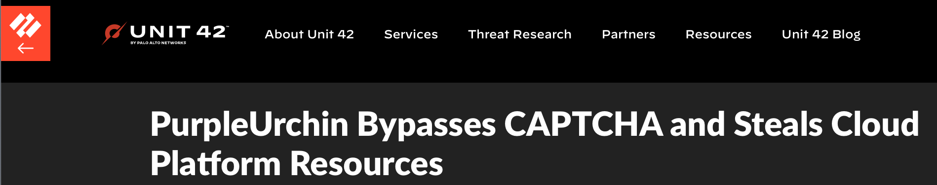
Other Changes
Notes:
Two other changes to briefly call out
1) Attacks on the Cloud continued, with the PurpleUrchin cryptomining campaign by Automated Libra (South African-based freejacking group that primarily targets cloud platforms offering limited-time trials of cloud resources). Unit42 wrote a really detailed blog on this one. The group are interesting for their heavy use of automated Github accounts (as often as 3-5 per minute), bypassing CAPTCHA with image analysis techniques, and creation of over 130K user accounts on smaller cloud platforms – seemingly with stolen credit cards. Because the cloud providers bill monthly they simply rack up crazy costs in the first month, and then refuse to pay – leaving the person whose details where stolen to deal with the mess

Slide 8
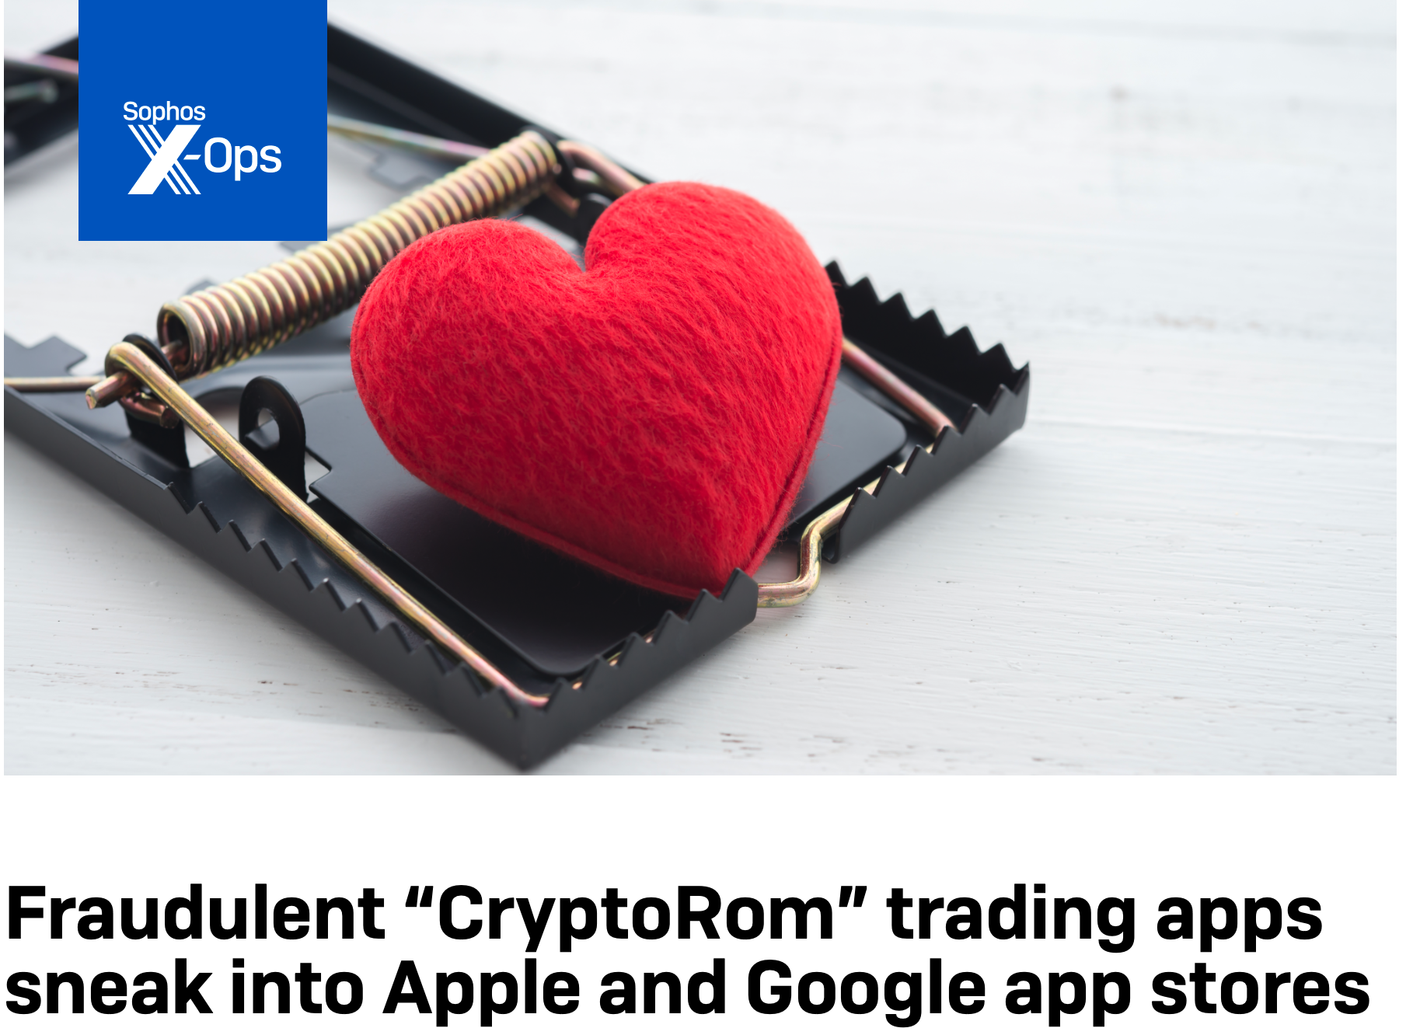
Other Changes
Notes:
And finally the increase of Crypto Romance scams targeting. More commonly known as Pig Butchering scams – but Sophos cute heart is a much nicer image to show that some stylised Hacker Pig being carved up. I do have to point out however that the Sophos Marketing team do not appear to know how to properly set a mouse trap, but I’m sure they make up for that skill in other areas
Essentially these scams are a combination of both classic (but effective) Romance Scams, combined with Crypto financial scams. You have to be all kinds of gullible to fall for these , but sadly a large percentage of the worlds population definitely fall into that category – and have little chance against the seasoned social engineers behind these attacks. This sort of Romance scam, along with attacks like BEC, actually outweigh Ransomware in terms of impact according to the latest US figures from FBI for cases reported to them.

Slide 9
2. Evergreen
What things we see that are not new, but still cause major damage - the EVERGREEN Cybercrime

Slide 10
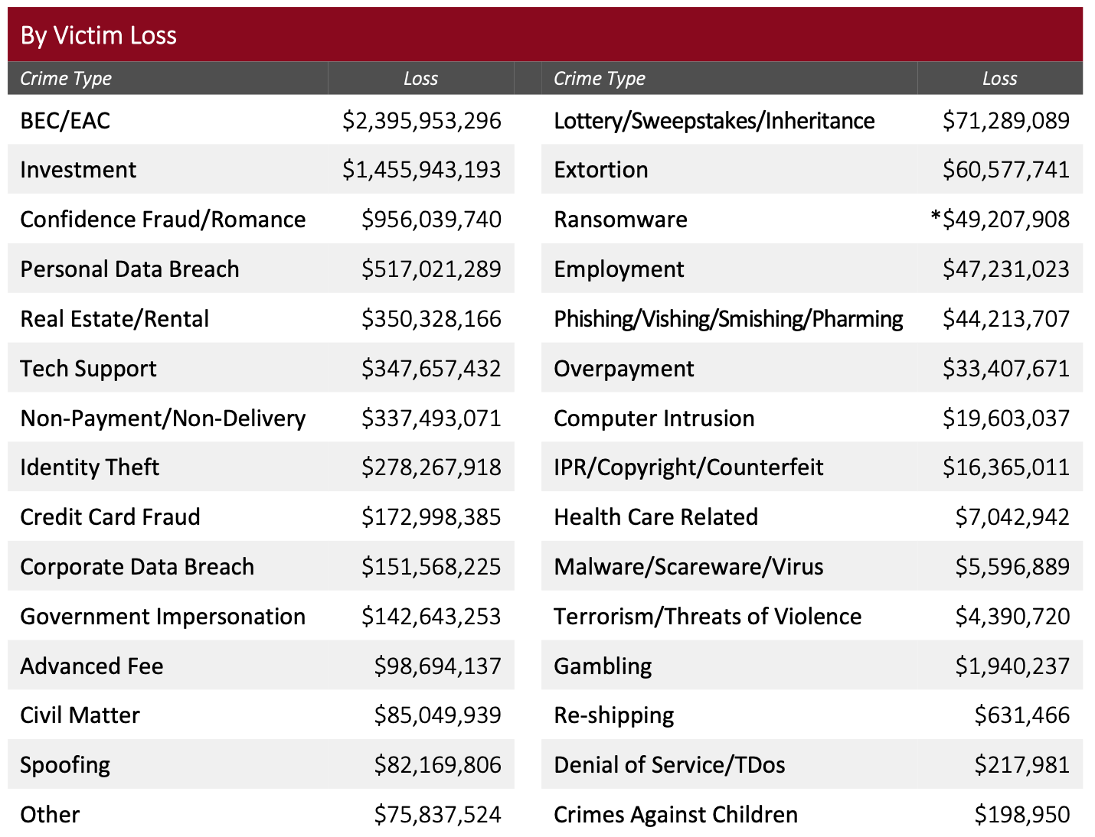
Business Email Compromise
2022
Increase in IR Cases
(Secureworks)
Notes:
Speaking of BEC – it is definitely on the rise, but silently so. The figures on the screen are from the 2021 FBI IC3 report – showing BEC as by far the biggest form of damaging Cybercrime compared to other types.
But in 2022 Secureworks IR figures showed an almost 2x increase in activity, despite there being no real advance in terms of TTPs for the attackers.
There are a couple of reasons for this 1) the old ways work well so there is little need for innovation

Slide 11
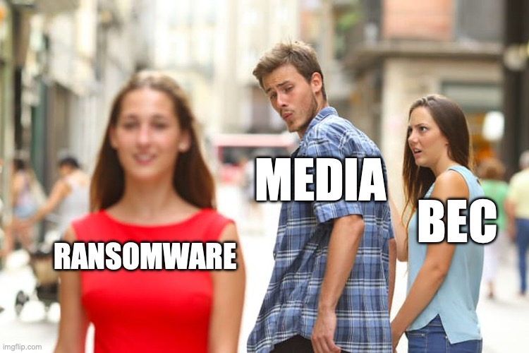
Business Email Compromise
Notes:
And 2) is this – its horribly under-reported in media. Its just not considered as likely to get a click on an article. And with it going under-represented in media, it gets less attention by boards and infosec alike – who are all scrambling around to try and stop Ransomware.

Slide 12
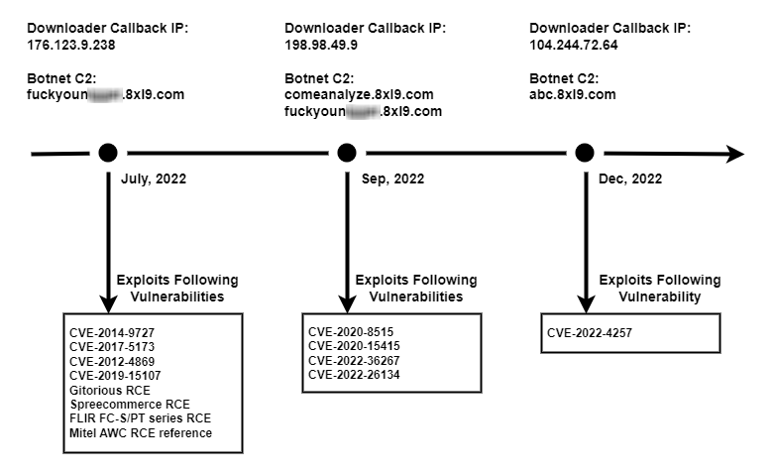
IOT Botnet: MIRAI V3G4
Notes:
Another area that no one talks about, but which are still very prevalent , are IOT botnets
These tend to be the usual mix of Mirai and other variants, like this Mirai variant spotted by Secureworks in February – but they come with an absolutely laundry list of vulnerabilities included like you can see on the screen. Everything from PBX Software, to Webcams, Modems, Wifi repeaters and Network Server software. While their payloads tend towards things like DDOS, the presence of any of these in your network should be taken as a sign of pretty woeful security hygiene. Sadly this does not stop them from compromising 10s of thousands of networks around the world

Slide 13
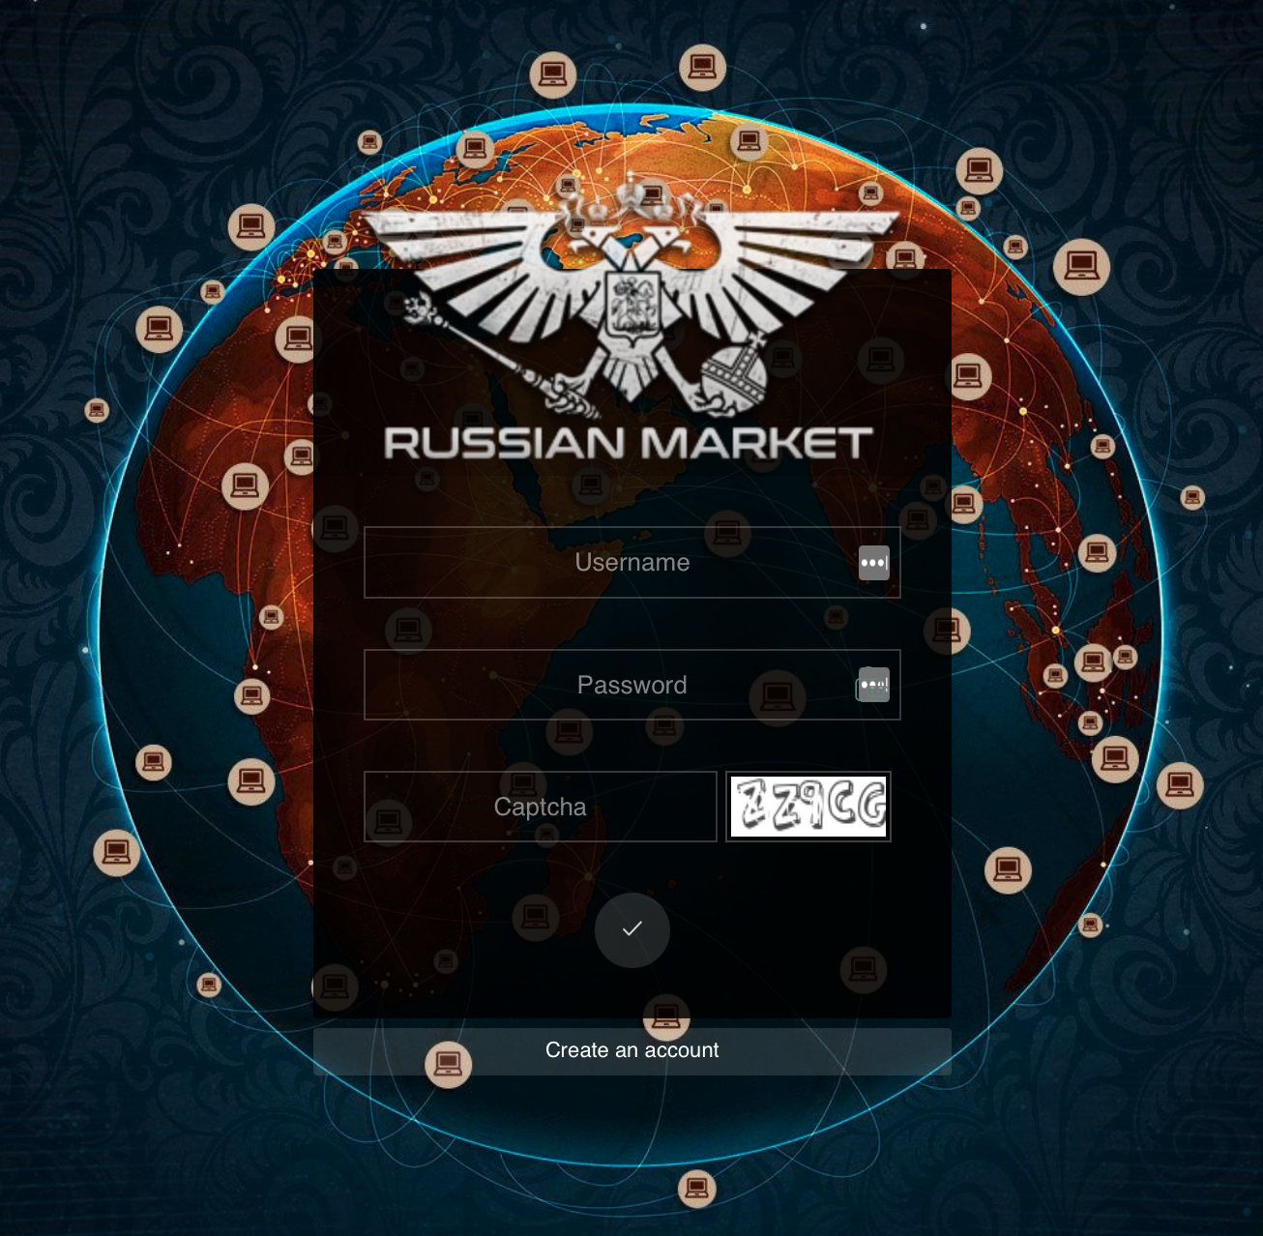
InfoStealer Markets
Infostealer Marketplaces increase in popularity with IAB
Popular Stealers (Feb 2023)
Racoon 2.1M logs
Vidar 1.8M logs
Redline 1.4M logs
Others lower / new (RisePro, Rhadamanthys)
Some drop in popularity (Azorult, Taurus)
Complicates Kill chains (e.g. Lockbit)
Notes:
Infostealer marketplaces continuing to add new logs at a rapid rate, and the use of logs as an initial access vector increased by some ransomware affiliates
If you look at the numbers they are huge. Racoon Stealer continues to evolve so its no surprised to see its popularity, adding a number of anti-evasion techniques
We see a number of Ransomware affiliates turning to these markets instead of direct hacks of victims due to their ease of use, and how well organised they are – allowing to really narrow in on key targets of interest and then simply buy credentials with a high chance of success.
An added benefit of stealer based IAB is that it really messes up investigation kill chains as there be a large time gap between stealer infection, and the next stage of an IAB moving around the network – and then a gap gain to the Ransomware deployment
For example one case was observed of Lockbit 2.0 delivered in a ZIP file also containing Vidar Stealer, and with both packed using the same packer.

Slide 14
Popular Evergreen TTP
Callback Phishing for Extortion (Luna Moth – ties to Conti)
Post Exploitation Frameworks (Cobalt Strike, Brute Ratel)
HTML Smuggling
Abuse of vulnerable drivers to kill EDR solutions (e.g. Backstab EDR tool)
Classic Loaders still solid (Bumble, Smoke, etc)
ISO / VHD related spam continues (often combined with LNK / LOLBins)
Notes:
A number of major TTP remain very consistent in recent months
- Callback phishing (aka telephone-oriented attack delivery (TOAD)) for extortion (without encryption/ransomware) related to the Luna Moth/Silent Ransom Group, which we believe may have possible ties to Conti. https://unit42.paloaltonetworks.com/luna-moth-callback-phishing/
Post Exploit – others beyond these 2 are rare. Cobalt Strike if anything is dropping in recent months – likely due to the amount of attention it gets from the industry, and being harder to crack in recent versions
Several of us saw a constant use of vulnerable well-known drivers to unload EDR software and allow post-compromise attacks to continue, although some new driver have shown up also. Both Lockbit and Blackcat have used the BackStab EDR tool for this
And finally ISO / VHD spam continues, often combined with LNK and LOLBin related kill chains

Slide 15
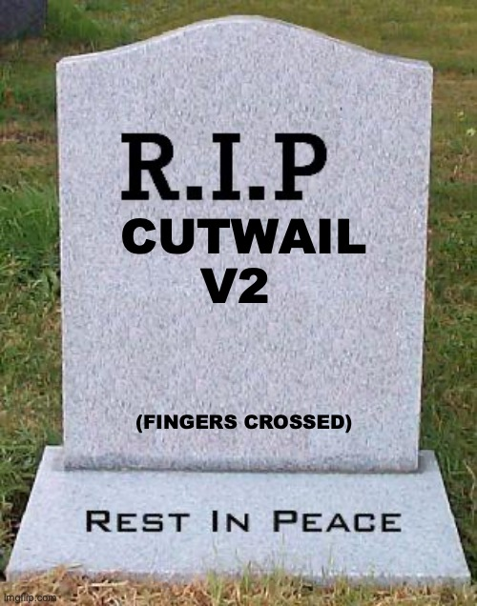
Spam delivery is dying … ?
Notes:
And finally a note on Spam Delivery botnets
o Cutwail v2 has not sent spam since 2 November 2022, and no communication with bots since 2 March 2023. This a long hiatus for the group, and is likely indicative of their ISFB customers going elsewhere. Difficult to speculate after a few days of total down time, but given the long run of prior operational inactivity, it might be that Cutwail has gone for good.
So if that’s not a reason for a post-SCIG celebratory beer, I don’t know what is.
However ….

Slide 16
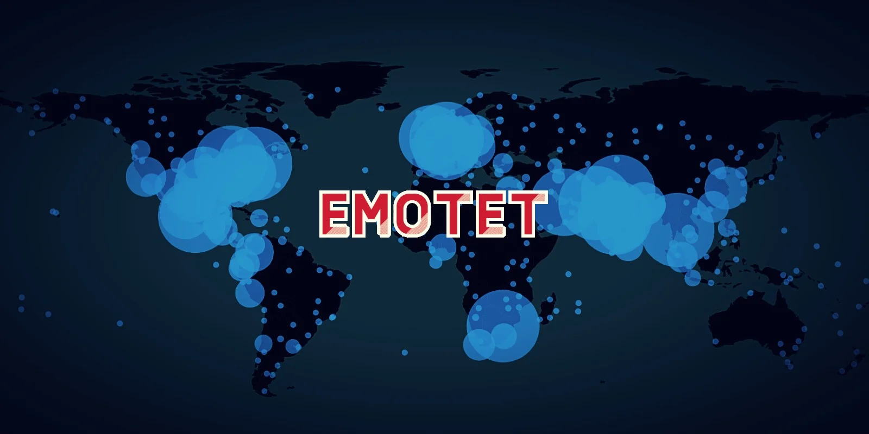
… its BACK!!
Notes:
Emotets spamming operation kicked back in on Tuesday for the first time since November 22nd , following a surge in updated C2s over the last month.
For now it seems the Emotet admins have not read the news that Macro attacks no longer work well, and it is still using excel / docs with macros to spread. They are using a TTP of bloated large docs and dlls which messes with a lot of Sandboxes. However it is HIGHLY likely that Emotet will follow other successful botnets like IcedID, Qakbot, Bumbleloader etc and leverage OneNote files instead in the coming weeks – which should drastically increase it success rate
If that’s not a reasons for NEEDING a drink post-SCIG, I don’t know what is ☺

Slide 17
3. Predictions
Top predictions for how things will change in the next 6 months
Notes:
And finally onto the Cyber Mystic Meg part of proceedings.
We’ll keep this area simple

Slide 18
One Note Usage + Bloated Files
Notes:
First up is OneNote usage . Expect this to be absolutely everywhere for the next couple of months until organization's get a good handle on it. Also we would be very surprised if Emotet have not started using this before the end of the month. We could see further diversification into other less common office files such as Publisher
In partnership with that a TTP that has been very successful for many Top Tier groups is File Bloating – it’s a simple approach but for optimization many AV engines and Sandboxes skip, or do less detailed analysis on, very large files

Slide 19
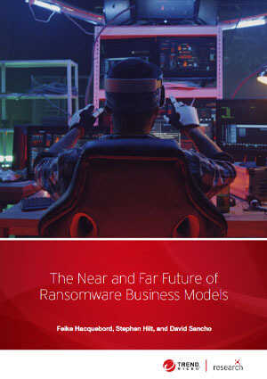
Ransomware Consolidation + Linux
Notes:
We can also expect in the next 3-6 months further consolidation of the Ransomware market, where the top 5 players or so will be responsible for more than 50% of all major attacks – and there will then be a long tail of constant churn after that.
Lockbit is likely to stay as its own organization – but there is a chance some of the smaller players could merge to optimize their businesses. What likely will make a change for the first time in a while is the re-emergence of Emotet. The Ransomware it starts to promote, possibly Quantum or Blackcat will see a significant increase in Market share as a result.
The Linux Server space, especially exposed ESXi servers is still a relatively untapped target rich environment for these groups – and it will make sense to see each major group have a least a Linux variant of their product to capitalize this . At least one of the smaller players will chose to try to corner this market also
For a view a little further out on where Ransomware groups can evolve to I can recommend the Trend Micro paper on the Near and Far Future of Ransomware released in December
https://www.trendmicro.com/vinfo/ie/security/news/cybercrime-and-digital-threats/the-future-of-ransomware

Slide 20
(Possible) Phishing / Scam Lures
Phishing and Scam sites like to follow whats worrying people in the news. Topics for the coming months
Cost of Living Crisis (Too good to be true deals)
Brexit V2 / Northern Ireland customs confusion
Big Caveat: These are very local concerns, and English language scams have to also factor in the US, CA, IE, AU etc
Notes:
Scams and Fraud site like to follow whats worrying people in the news. Topics for the coming months – are shown on screen
However a big Caveat here to factor in, which is why I would say likelihood here is not so high - These are very local concerns, and English language scams have to also factor in the US, CA, IE, AU etc
For example the Cost of Living Crisis is not so much of a major news item in Ireland

Slide 21

ChatGPT Lowers barrier for entry
Notes:
And finally – the emergence of ChatGPT makes coding much easier. While it does have some issues with lying in generated human readable text, when it comes to programming its excellent – no surprise considering that is computers language of choice
There are safeguards in place for creating malicious code – but they are trivial to bypass, and while there may not be malware that fully leverages it in the next 6 months – it really speeds up the learning and skill curve for any would be script kiddie looking to create malicious code in Powershell, Python, GoLang etc. So expect the barrier for entry to the malware scene to drop significantly in the coming months on forums like Hackforums and others – something the Prevent teams should be keeping an eye out for

Slide 22
Bob McArdle
Robert_McArdle@trendmicro.com
Notes:
Again Special Thanks to everyone!

